Slide 1
UNIT 2: Networks in Cloud Computing
OUTLINES:
Introduction to cloud networking
Parallel and Distributed Computing
Network Architecture for Cloud: Data Center , Difference between Cloud and Data centre.
Virtualization Technology
Cloud Automation
Hybrid Cloud Networking
Autonic Computing
Open Source Software in Data Center

Slide 2
What is Cloud Networking?
type of IT infrastructure in which some or all of an organization’s network capabilities and resources are hosted in a public or private cloud platform, managed in-house or by a service provider, and available on demand.
Companies can either use on-premises cloud networking resources to build a private cloud network or use cloud-based networking resources in the public cloud, or a hybrid cloud combination of both.

Slide 3
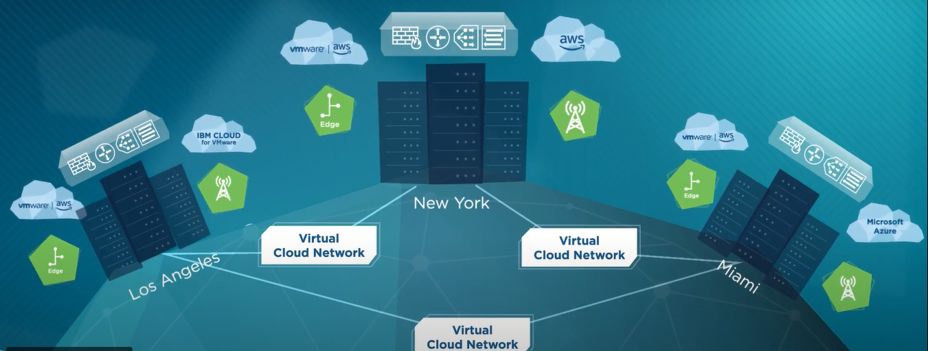

Slide 4
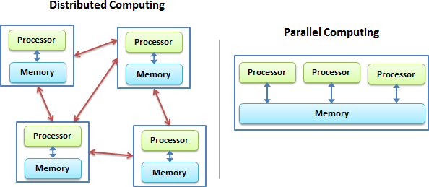
Parallel Computing and Distributed Computing:

Slide 5
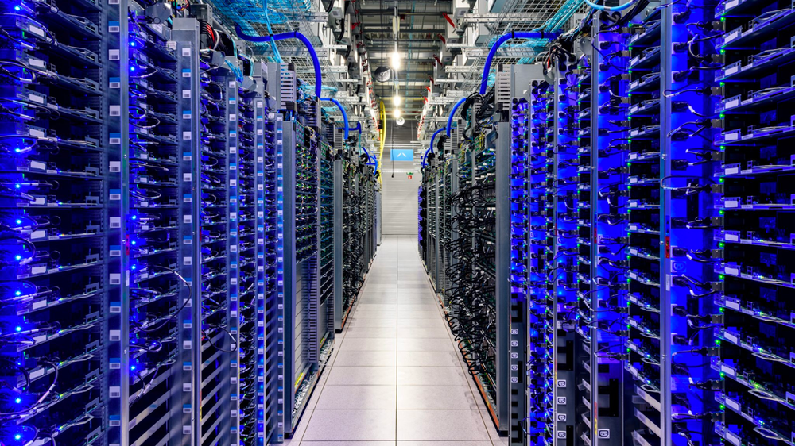
Network Architecture for Cloud: Data Center Network and cloud data centre
A data centre centralizes an organization’s shared IT operations and equipment for storing, processing, and disseminating data and applications.
Data centre is only for particular organization.
Cloud is for all
data centre has limitations on resource as well.
Data Center is one of the major resource for cloud computing too.

Slide 6
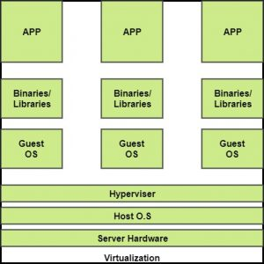
Virtualization Technology
Virtualization is a technique of creating a virtual version of something like computer hardware.
It was initially developed during the mainframe era. Example Cloud Computing

Slide 7
BENEFITS OF VIRTUALIZATION
1. More flexible and efficient allocation of resources. 2. Enhance development productivity. 3. It lowers the cost of IT infrastructure. 4. Remote access and rapid scalability. 5. High availability and disaster recovery. 6. Pay per use of the IT infrastructure on demand. 7. Enables running multiple operating systems.
Types of Virtualization:
1.Application Virtualization.
2.Network Virtualization.
3.Desktop Virtualization.
4.Storage Virtualization.
5.Server Virtualization.
6.Data virtualization.

Slide 8
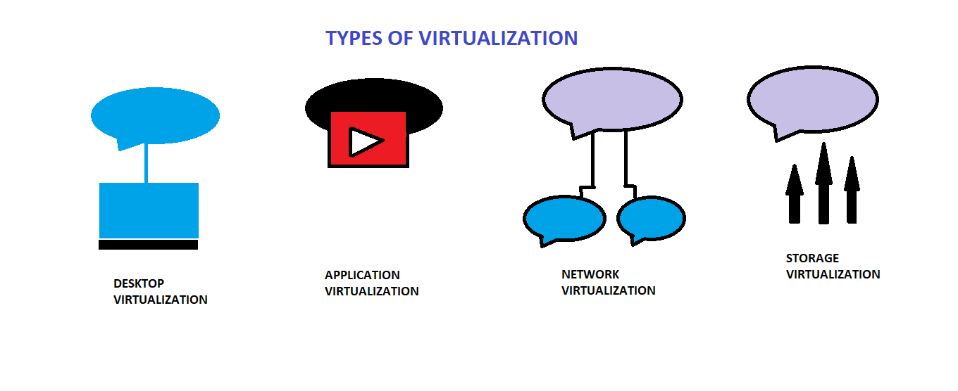

Slide 9
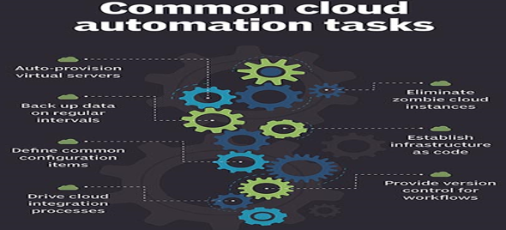
Automation in Cloud Computing
To create, modify, and tear down resources on the cloud automatically.

Slide 10
Benefits of Automation of CC
Improved security and resilience
Improved backup process
Improved governance

Slide 11
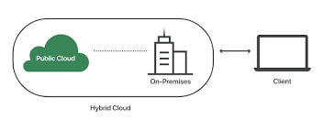
Hybrid Cloud Networking
Hybrid cloud computing is an environment that creates flexibility by allowing a business to use both public and private networks for different uses

Slide 12
Concept of Autonomic Computing
Autonomic computing is a computer's ability to manage itself automatically
Learns automatically from learning the behaviour or activities of computer
to resolve system difficulties and other maintenance such as software updates.
Cut down the effort and time of developers and IT care takers.
It was proposed by Jiming Liu in the year 2001
IBM has defined the four areas of automatic computing:
Self-Configuration.
Self-Healing (error correction).
Self-Optimization (automatic resource control for optimal functioning).
Self-Protection (identification and protection from attacks in a proactive manner).
Characteristics that every autonomic computing system should have include
automation,
adaptivity and
awareness.
It uses artificial systems to solve complex problems using imitations like that of humans.

Slide 13
Open Source Software in Data Centres.
DCImanager
It is a platform for managing physical equipment: servers, switches, PDU, routers and monitoring server and data centre resources.
2. Opendcim
Currently, it’s the one and the only free software in its class and alternative to DCI manager
3. Foreman
It is an open-source and perfect life-cycle management application for physical and virtual servers using linux.
4. LinMin
LinMin has a well-developed backup system for hard drives, that speeds up an after-crush recovery during disasters
5. CenterOS
It’s an operating system for a Data Center management with the main focus on equipment inventorying.
6. Device 42
Mostly designed for a Data Center monitoring. Has great tools for inventorying, builds hardware/software dependence map automatically.

Slide 14
7. RackTables
RackTables is an open-source tiny tool for datacenter and server room asset management to keep track of everything
8. NetBox
NetBox is an open-source IP address management and data center infrastructure management platform

Slide 15
END of the UNIT 2

